Slide 1


K.RAMAKRISHNAN COLLEGE OF TECHNOLOGY
(AUTONOMOUS), TRICHY
HOUSE RENTAL SYSTEM
PRESENTED BY : SUPERVISOR:
THARANITHARAN K, Mr.A.MALARAMANNAN,M.E.,
2303811710421169 AP/CSE.
Notes:
1

Slide 2
PRESENTATION OVERVIEW
Objective
Project Introduction
Problem Statement
Methodologies (Programming concepts relevant to problem statement)
Architecture of the proposed system
List of Modules
Merits
Results and Discussion
Queries
Notes:
2

Slide 3
OBJECTIVE
The objective of the "House Rental System" is to create an efficient and user-friendly platform for tenants and homeowners to interact. It simplifies house renting by allowing homeowners to list properties and tenants to search and book properties online.

Slide 4
PROBLEM INTRODUCTION
The "House Rental System" is a Java-based application designed to facilitate seamless communication between homeowners and tenants. The system includes modules for user registration, house listing, booking, and management, ensuring ease of use for both tenants and homeowners. The admin oversees user activities to maintain system integrity.

Slide 5
PROBLEM STATEMENT
Traditional house rental processes are often time-consuming and lack transparency. Issues such as difficulty in finding suitable properties, lack of direct homeowner-tenant communication, and inefficient management lead to delays and inconveniences. The "House Rental System" aims to resolve these challenges by providing a digital platform for renting and managing houses effectively.

Slide 6
Methodologies (Programming Concepts Relevant to Problem Statement):
Java AWT and Swing for creating a graphical user interface.
Array concepts for managing user data and house listings efficiently.
Authentication Mechanisms to validate admin, tenant, and homeowner credentials.
Search Functionality enabling tenants to locate houses based on location.
Event Handling to trigger pop-up notifications and manage user actions dynamically.

Slide 7
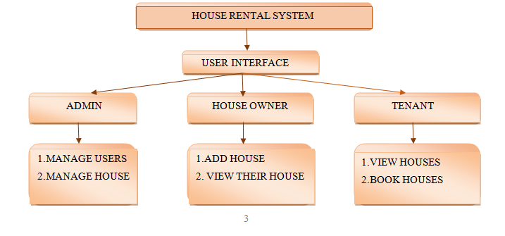
ARCHITECTURE DIAGRAM
IIIIIIIIIIIIIIIIIII
IIIII

Slide 8
MODULES
Admin Module: Manages users, houses, and ensures system security.
Tenant Module: Registers, logs in, searches for houses, and makes bookings.
Homeowner Module: Adds houses and manages existing listings.
House Management Module: Manages house data and updates availability after booking.
Authentication Module: Validates login credentials for all users.

Slide 9
MERITS
Simplifies house renting through a digital platform.
Enhances transparency between homeowners and tenants.
Provides real-time updates on house availability.
Pop-up notifications improve user experience.
Array-based implementation reduces complexity compared to file or database systems.

Slide 10
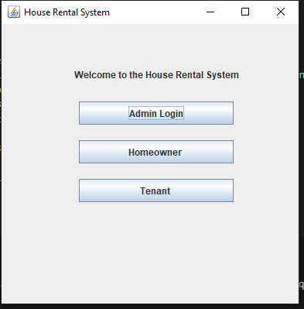
RESULTS AND DISCUSSION
HOME PAGE :

Slide 11
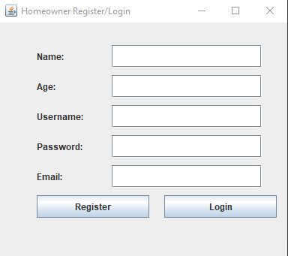
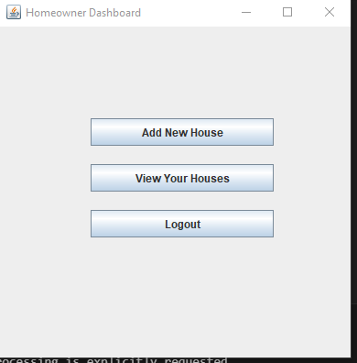
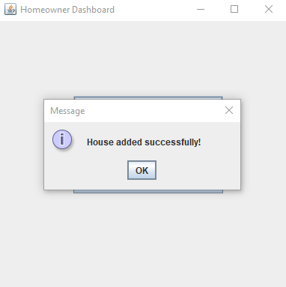
RESULTS AND DISCUSSION
HOUSE OWNER:

Slide 12
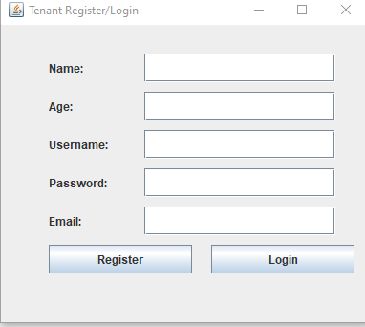
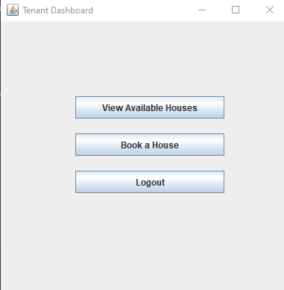
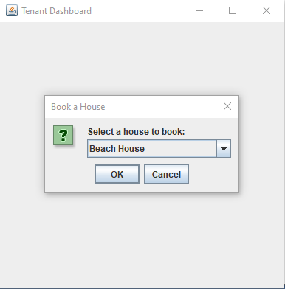
RESULTS AND DISCUSSION
TENANT :

Slide 13
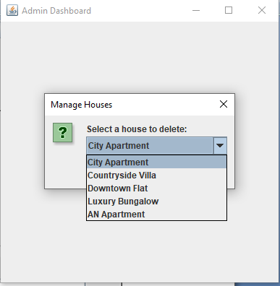
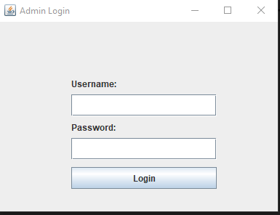
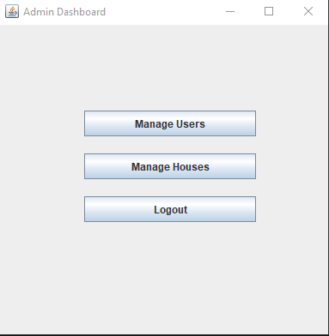
RESULTS AND DISCUSSION
ADMIN :

Slide 14
ANY QUERIES ?

